Slide 1
RateRadar
Team Details:
Jasleen : 2310992107
Ishika Dhawan : 2310992101
Shreya :2310991212
Faculty Co-ordinator: Dr. Kirandeep Singh
:
Chitkara University Institute of Engineering and Technology,
Chitkara University, Punjab

Slide 2
Table of Contents
Introduction
Technical Details
Frontend
Backend
Project Flow
Key Features
Project Highlights
Conclusion

Slide 3
Introduction
Project Overview:
This project, RateRadar, is a dynamic review submission and display platform designed to allow users to share and view reviews for various places . Built using Node.js and a basic server-side architecture, it offers functionality for users to submit their reviews via a form, which includes fields such as name, email, place address and relevant details like a place name .

Slide 4
Technical Details
Technologies Used:-
Frontend: HTML , CSS, JS
Backend: Node.js, File System(fs module)
Data Storage: JSON Files

Slide 5
Frontend
HTML Structure:
Used to create the structure of the forms and pages.
Contains form elements such as input fields, submit buttons.
User Interaction:
User submits personal information such as name, email, place name and place address.

Slide 6
CSS-
Design and Layout:
Used to style the forms .
Color schemes, fonts, and layout adjustments for a user-friendly interface.

Slide 7
JavaScript-
Dynamic Content Handling:
Fetching data from the backend using the fetch() function.
Populating the form with user information dynamically.
Submitting form data to the backend via POST requests.

Slide 8
Backend
Server Setup:
http module: Creates a server to handle incoming requests.
fs module: Reads and writes data to a reviews.json file.
qs module: Parses form data sent in POST requests.
Request Handling:
GET Request: Fetches data from the reviews.json file and sends it as a response (for displaying all student data).
POST Request: Receives form data, stores it in reviews.json, and responds with a success page.

Slide 9
Data Storage:
Data is stored in a JSON file (reviews.json), where each new review is appended.

Slide 10
Project Flow:
User fills the personal information form.
Data sent to server via POST.
Server stores data in JSON file.
Admin can view all reviews under the USER REVIEWS section using the GET request.

Slide 11
Key Features
User-Friendly Design
Compelling Visuals
Responsive Design
Clear and Organized Content Layout
Interactive Data Display
Success Confirmation
Error Handling
Data Storage Integration
Backend Processing
Integrated Resource Links.

Slide 12
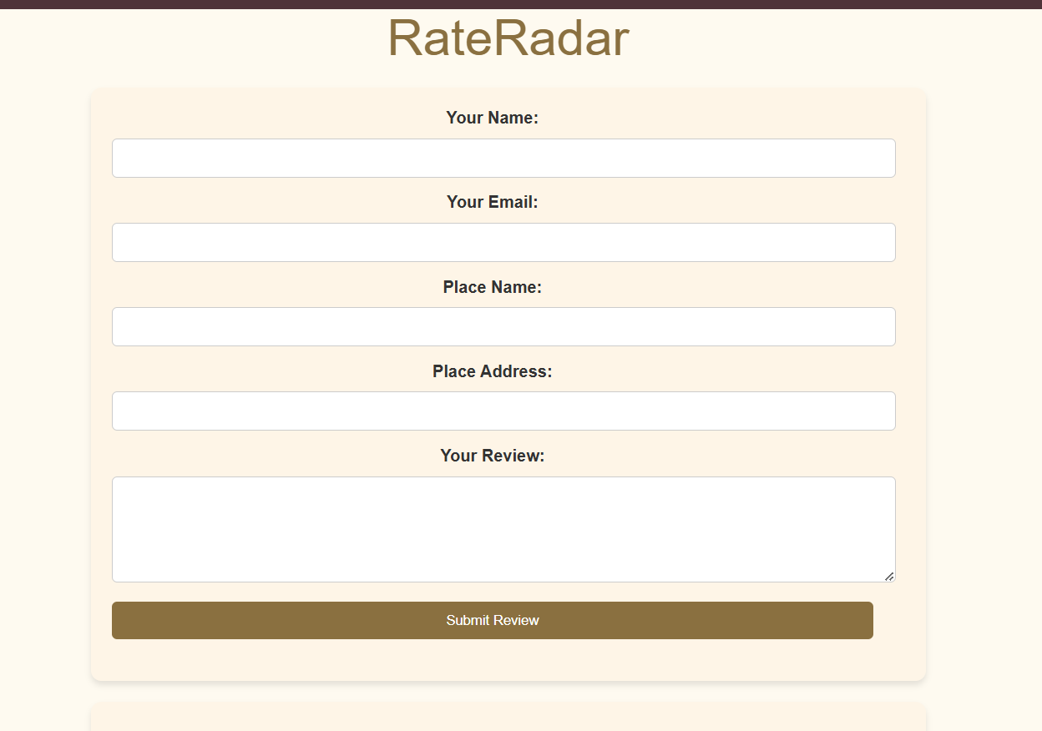
Project Highlights

Slide 13
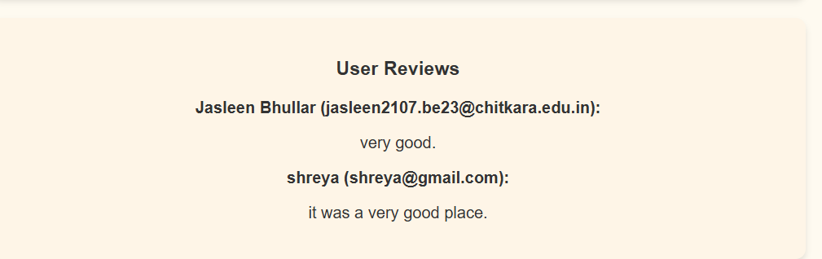

Slide 14
Conclusion
Teamwork and Learning

Slide 15


